Slide 1


Slide 2
MANTISHRM
Prepared by: Justine Siccion Johann Alpapara

Slide 3


Slide 4

Project Context

Slide 5


Purpose and Description

Slide 6

Problems
Paper Based Processes
Human Error
Duplication of work
Significant use of staff time

Slide 7

Objectives
General Objectives
To remove the paper-based processing of information.
To maximize the use of staff time and energy.
To avoid the instances of human errors.
Specific Objectives
To have faster processing of information.
To provide the client with a human resource management system.
To implement the system to the Human Resources Department.

Slide 8
Scope and Limitations
HR department only
Leave Processes
Employee Information processes

Slide 9
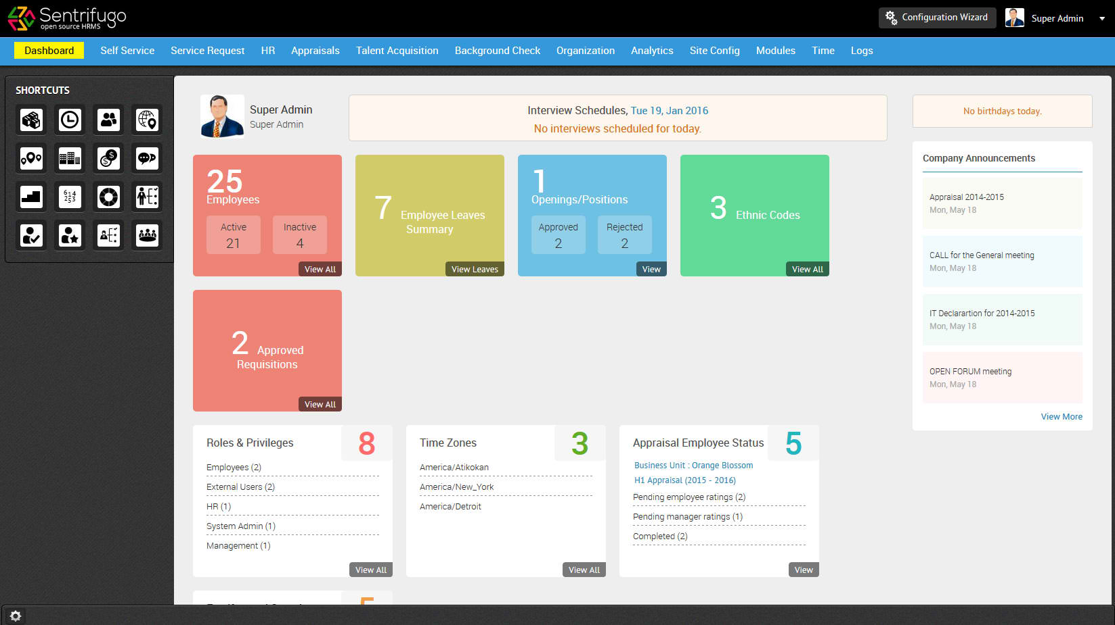
Review of Related Literature
Open Source Human Resource Management
Software supported by Sapplica Info Technologies.

Slide 10
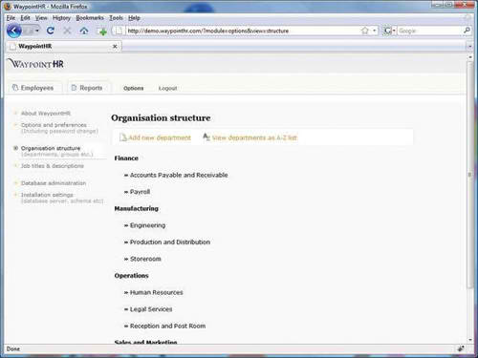
WaypointHR provides a flexible Human Resource Information System (HRIS) developed by HR-Fundamentals ltd, primarily for UK, European and US employers.

Slide 11
Technical Background
Personnel Information Management (PIM) Module
Leave/Time off Management Module

Slide 12
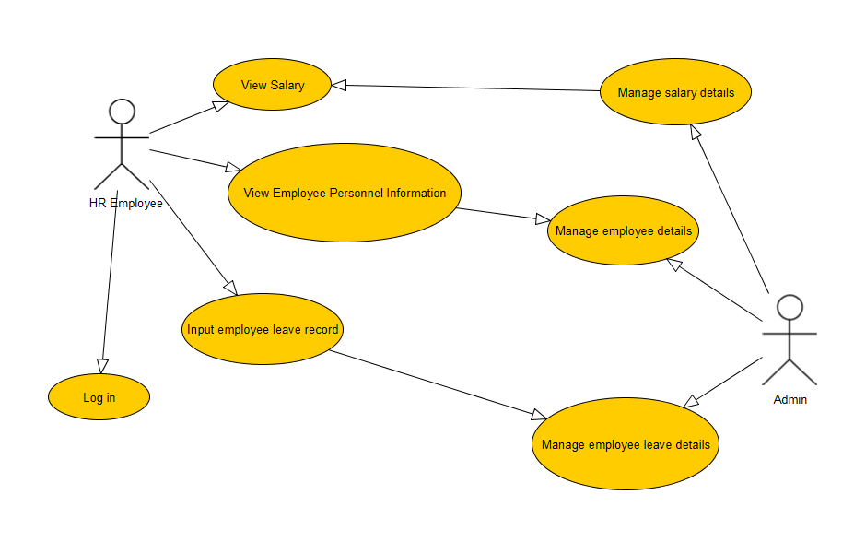
Use Case Diagram

Slide 13
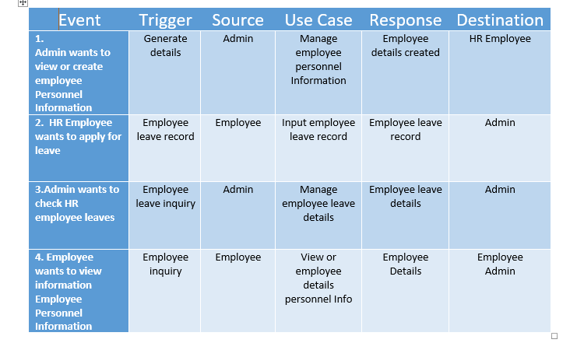
Event Table

Slide 14
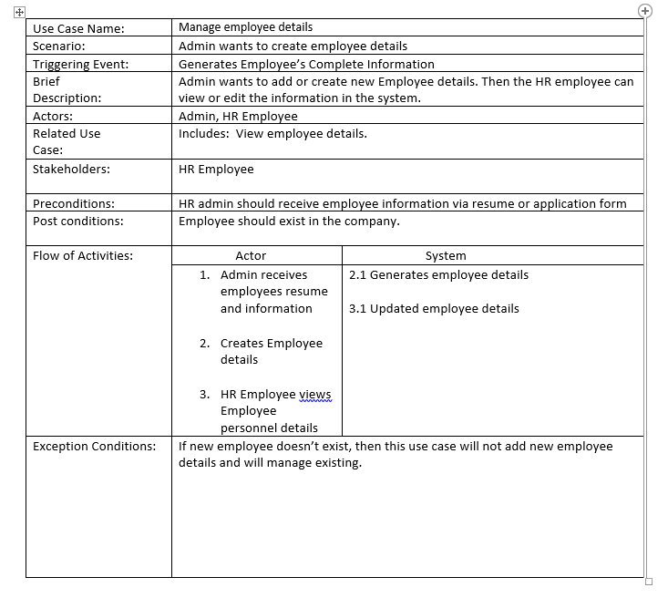
Use Case Full Description

Slide 15
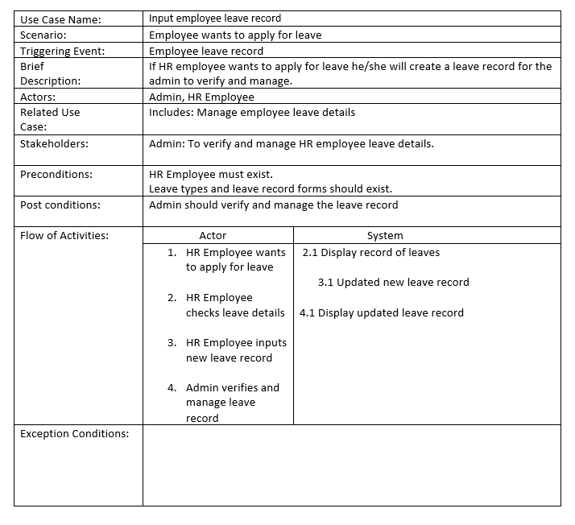

Slide 16
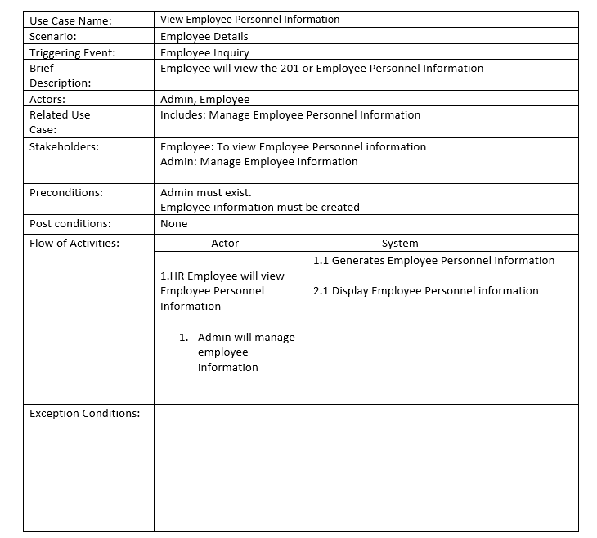

Slide 18
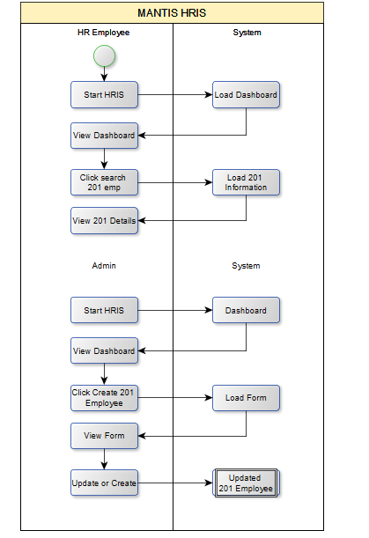

Slide 19
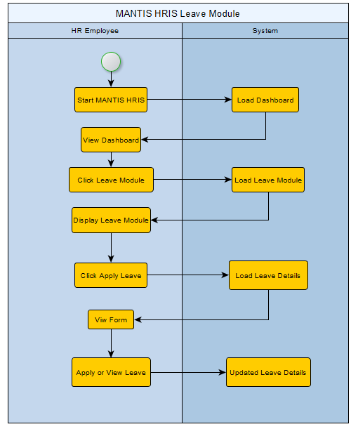
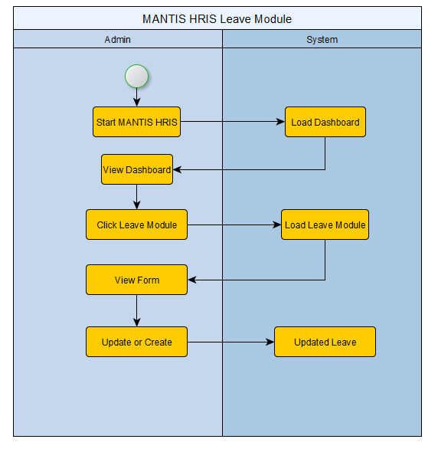
Activity Diagram

